Slide 1
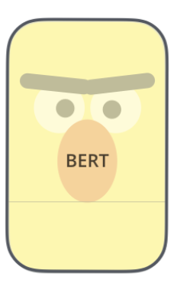
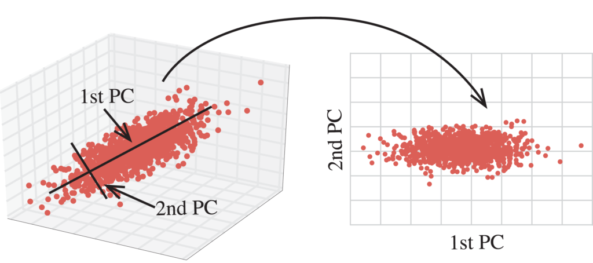
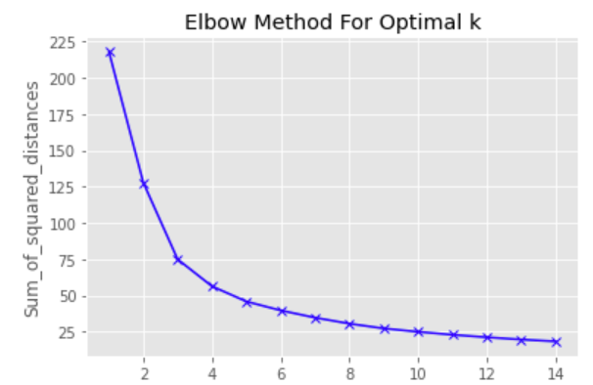
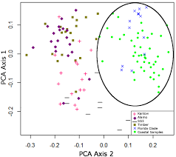
Texts
Embedding
Sentence-BERT
Dimensionality Reduction
PCA
Look for optimal K
Kmeans
Clustering
Elbow Method

Slide 2
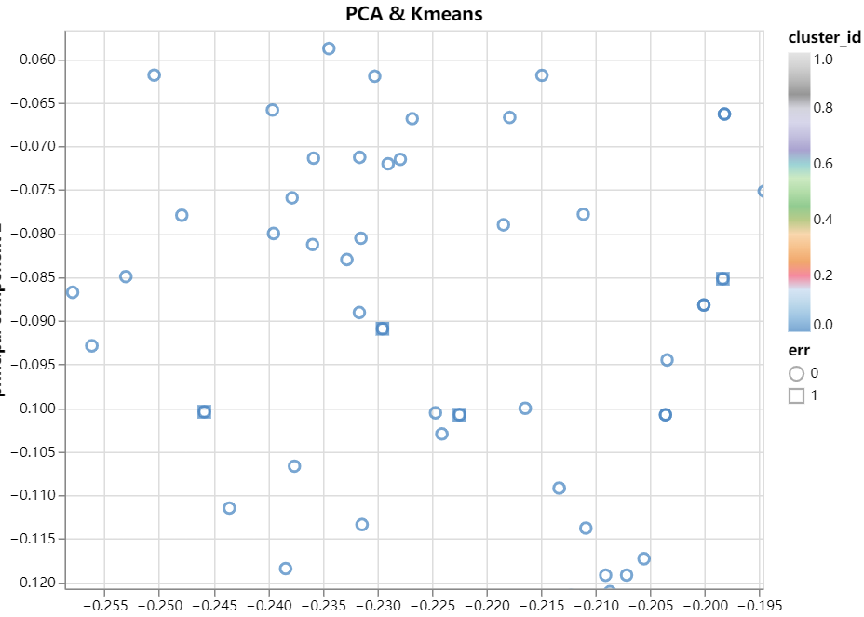




Slide 3



